Slide 1

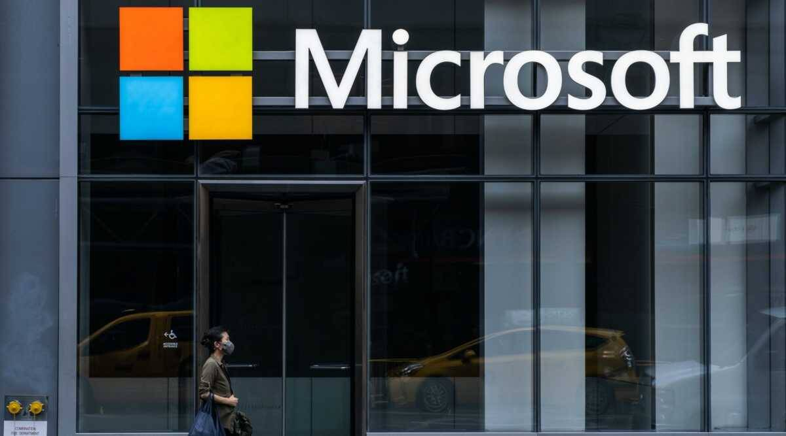



Green Initiatives Taken by Organizations

Slide 2



OUR TEAM Submitted By
East West University
Course Title: Green Computing
Course code: 407 Section: 02
01
02
Submitted To
Samiha Karim Chowdhury
2019-3-60-100
Faiyaz Uddin
2019-2-60-082
Dr. Ahmed Wasif Reza
Associate Professor Department of Computer Science & Engineering
03
04
S M Arafat Rahman
2019-2-60-094
Sumi Akter
2019-3-60-101

Slide 3

Literature Review
01
Google
02
University of\ Michigan
03
Microsoft
24/7 Carbon-Free Energy by 2030
Looking ahead - clean energy and the path to net-zero emissions
Making virtualization enables one physical server to run many independent programs and/or operating systems.
to empower every person and every organization on the planet to achieve more

Slide 4
Problem Statements/ Research Question
01
02
03
How do they maintain Green IT standardization?
How do they think of consume IT energy?
What initiatives the take or will take to make a sustainable future?

Slide 5

Objectives
01
Cooling and power consumption
02
Sustainability
03
Green IT Standardization

Slide 6

Research Methodology
Qualitative research
Quantitative research
Sampling
Quantitative analysis

Slide 7

01
DATASET / MATERIALS
02
03

Slide 8
Steel 29%
Lead 8%
Glass 22%
Plastic 29%
Aluminium 10%
Copper 7%
Zinc 3%
Energy and Environmental Impact of Google
1. data centers emits 35.9 million metric tons CO₂e annually.
2. Manufacturing accounts for 60-85% of a personal computer's life cycle energy demand and 50-60% of mobile phone energy demand. Remanufacturing energy accounts for 5-30% of manufacturing energy in personal computers and 5% in mobile phones.

Slide 9
01
02
03

Slide 10
Embodied GHG emission of UoM
1. Office equipment energy consumption could be reduced by 23% if all office equipment had and utilized low-power mode. If all desktop computers and printers were turned off for the night, energy consumption would be further reduced by 9%.
2. Energy Star certified computer servers are, on average, 30% more energy efficient than standard servers. If all servers in the U.S. met Energy Star standards, $1 billion in energy would be saved and 8.2 million metric tons of GHG emissions would be avoided per year.
3. Energy consumed by devices in standby mode accounts for 5-10% of residential energy use. Unplug electronic devices when not in use, or plug them into a power strip and turn that off.42 Turning off a computer when it is not in use can save $50, 505 kWh, and 415 lbs of CO₂ per computer annually.
Kg CO2
Recker SErvert
LCD Monitor
Full-Size Desktop
Laptop
Recker SErvert
Recker SErvert
Recker SErvert

Slide 11
01
02
03

Slide 12
Microsoft Emission Scope 1,2,3
Microsoft charges its own internal business groups a real fee on their emissions as an incentive to drive them down and a way to raise capital for funds that reward sustainable innovation internally.
Few companies have begun to measure their Scope 1 or 2 emissions, let alone reduce or remove them. Even fewer have done this for Scope 3.
Additionally, the company extended this real fee from its Scope 1 and 2 emissions out to Scope 3, which are the indirect emissions associated with its supply and value chain.
Metric tons CO2 e

Slide 13

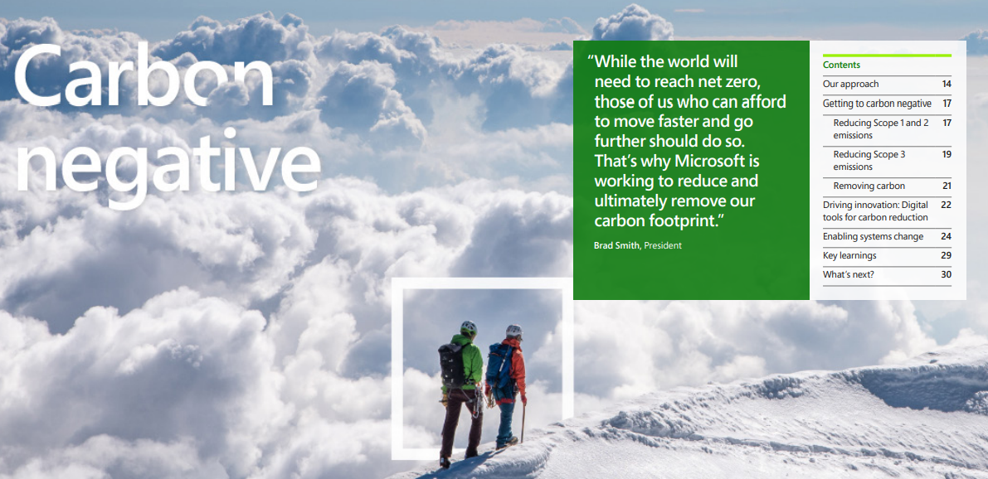
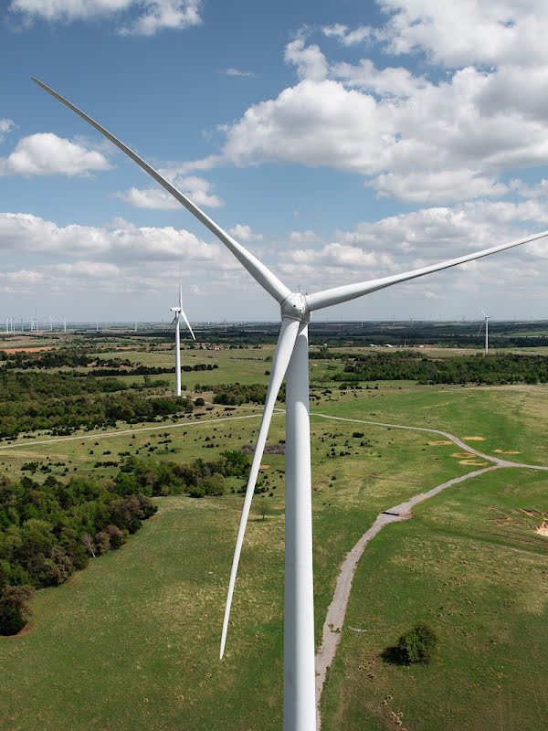
Results Analysis and Discussions
Flexible work option
Remote employment
AI powered social
platform
Build the future

Slide 14
Summary of Research Findings
Google
University of Michigan
Microsoft
01
03
05
Deep Mind AI reduction energy used for
cooling Google data centers by 40%
Energy consumption reduced by low power mode in office equipments
Focused on reducing scope1 and scope2 emission
02
04
06
Remanufacture the energy in personal computers
Using energy star certified computer servers
Raised awareness and fund for sustanable innovation

Slide 15
Future Works
Google
University of Michigan
Microsoft
CLOUD DATA CENTER
HYBRIDE WORKSPACE
BUILD SUSTANABLE FUTURE

Slide 16
Potential Industrial Applications
Google glass for the future
Introducing smart factory and smart workers
Trusted cloud for manufacturing
Intelligent industry innovation

Slide 17

Reference
Google sustainability, Our sustainability efforts and progress- Google.
24/7 Clean Energy – Data Centers – Google.
Deep Mind AI reduces energy used for cooling Google data centers by 40% ,Google.
Batter waste handout, University of Michigan.
Planet blue, UMIH education.
Sustainable purchase, procurement, UIMH.
Seas, UMIH education.
Corbett, J. (2010) Unearthing the value of Green IT.
ICIS Proceedings (2010): 1-21. 2.
Lawrence Berkeley National Laboratory (LBNL) (2016)
United States Data Center Energy Usage Report.

